Slide 1
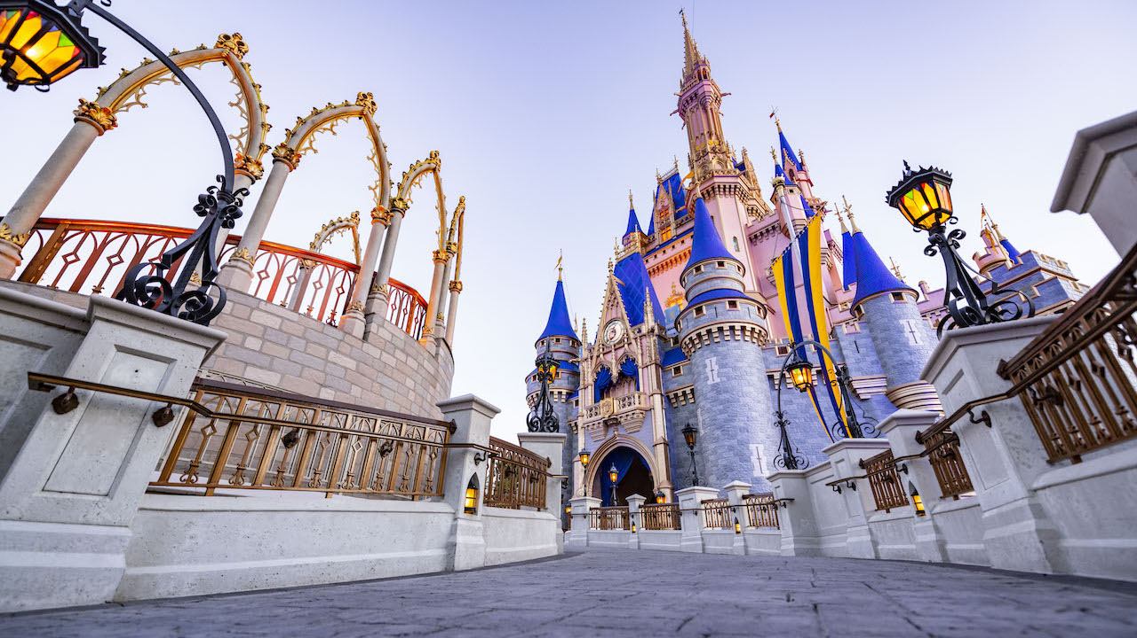
GA Data Science Capstone Project: Predicting Attraction Popularity at Walt Disney World
Christopher Doughty
October 14, 2021

Slide 2
Problem
The Disney Parks branch of the Walt Disney Company wants to improve the guest experience by “imagineering” the best ride attractions possible – those that will have the most appeal to the broadest audience
Accordingly, it is seeking to design a recommendation tool that will facilitate smoother park experiences from among existing attractions, as well as determine what types of attractions to develop for future projects

Slide 3
problem
Questions:
Are there certain attributes that make a ride at Walt Disney World more or less appealing?
Could we make an algorithm that would predict the popularity of a ride?
Objectives:
Determine if there are any ride attributes that are likely to make an attraction more or less appealing.
Create a model that can accurately predict the popularity (rating) of a ride.

Slide 4
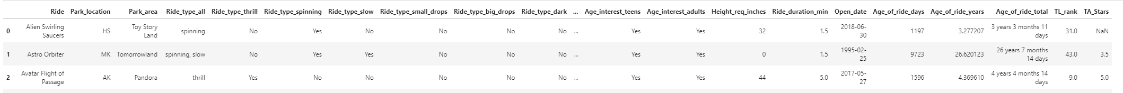
Data set
Obtained Walt Disney World Ride Data from data.world: https://data.world/lynne588/walt-disney-world-ride-data
Contains features such as park location, ride type, duration, ride age, height req., and age interest group for each ride
Pre-cleaning: 46 rows x 28 columns | Post: 45 rows x 24 columns
Deleted 1 row (no review page), updated review data (data was originally compiled on October 23, 2019), renamed/lowercased columns, changed data types (string to Boolean), deleted 4 columns (irrelevant info, duplicated info, high correlations)

Slide 5
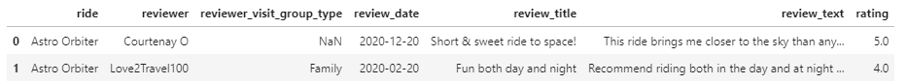
Data set
Scraped individual review data from TripAdvisor for each of the attractions in the WDW Ride Data (through Oct. 9, 2021): https://www.tripadvisor.com/Attractions-g34515-Activities-a_allAttractions.true-Orlando_Florida.html
Contains features like review date, review title, review text, and rating for each ride; initial cleaning in Excel, secondary in Jupyter
Pre-cleaning: 9,843 rows x 7 columns | Post: 9,843 rows x 5 columns
Dropped features not prepared to use for this analysis (nulls requiring imputation, time series data)

Slide 6
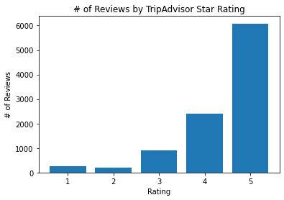
analysis
Joined the data sets together (9,843 rows x 28 columns)
Data set is very imbalanced – way more 4- and 5-star reviews than 1-3 star reviews
Rating | % | #
5 | 62% | 6,081
4 | 24% | 2,393
3 | 9% | 902
2 | 2% | 212
1 | 3% | 255

Slide 7
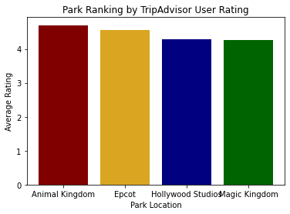
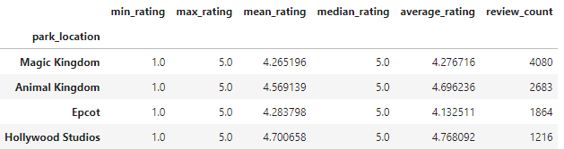
analysis
Each park is very similar in terms of rating distributions
Magic Kingdom has more reviews than the other parks, but it also has more rides – the number of reviews generally aligns with the number of rides

Slide 8
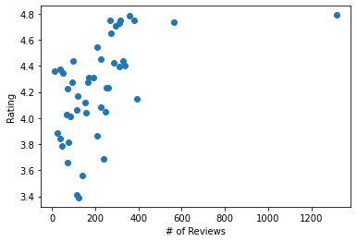
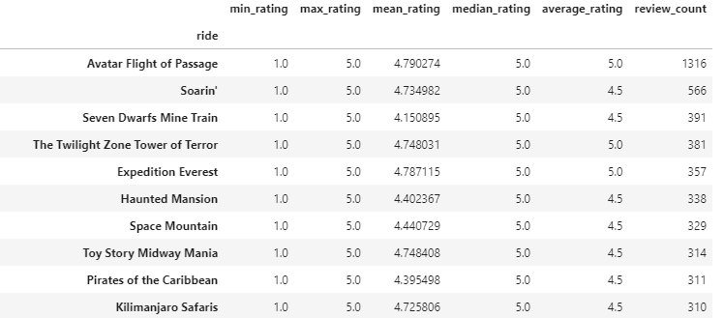
analysis
Avatar: Flight of Passage has way more reviews than any other ride, but its rating distributions are reflective of the overall data set (mostly positive reviews)

Slide 9
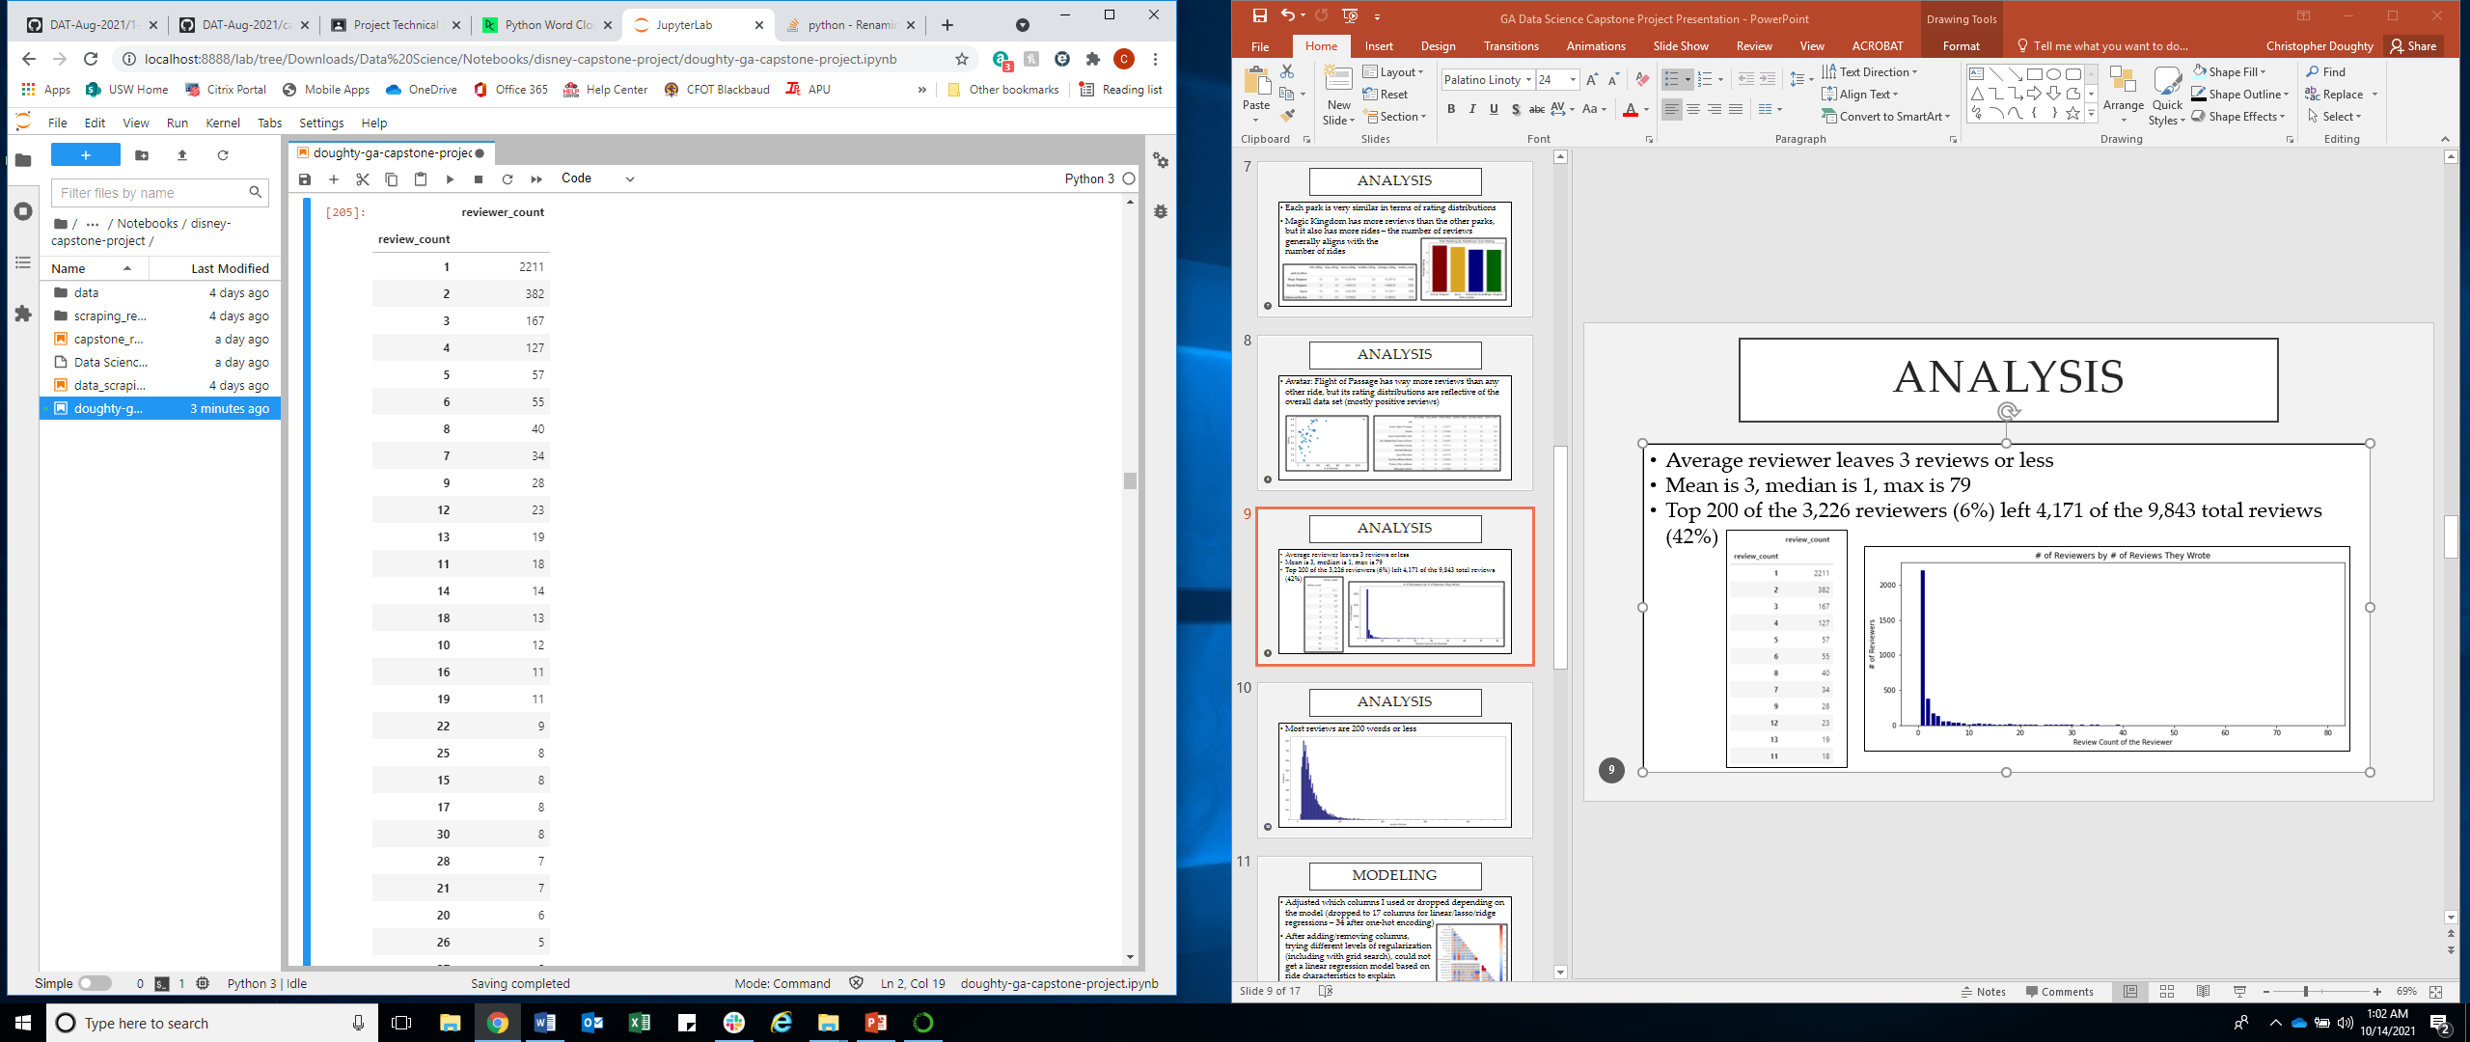
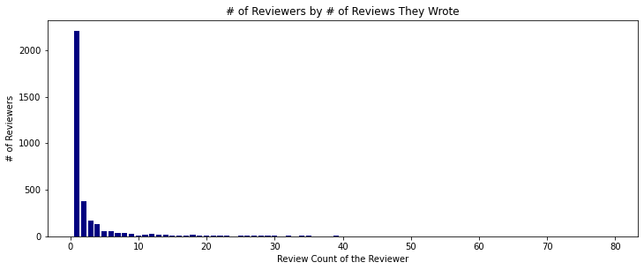
analysis
Average reviewer leaves 3 reviews or less
Mean is 3, median is 1, max is 79
Top 200 of the 3,226 reviewers (6%) left 4,171 of the 9,843 total reviews (42%)

Slide 10
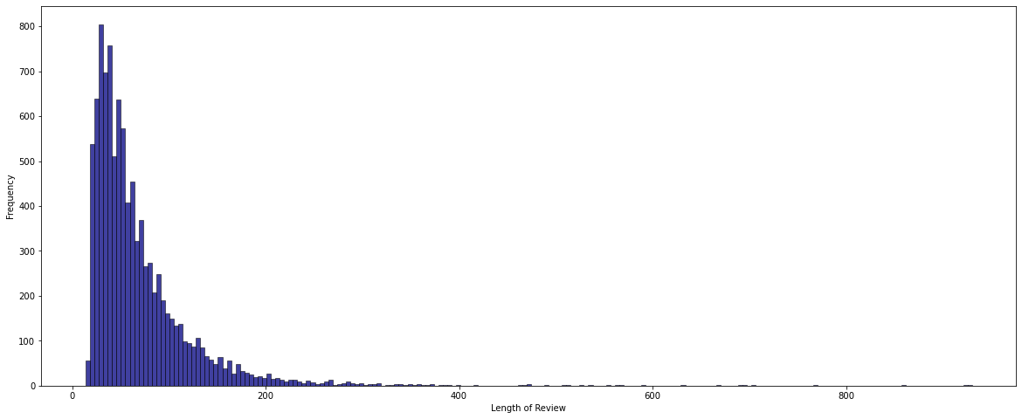
analysis
Most reviews are 200 words or less

Slide 11
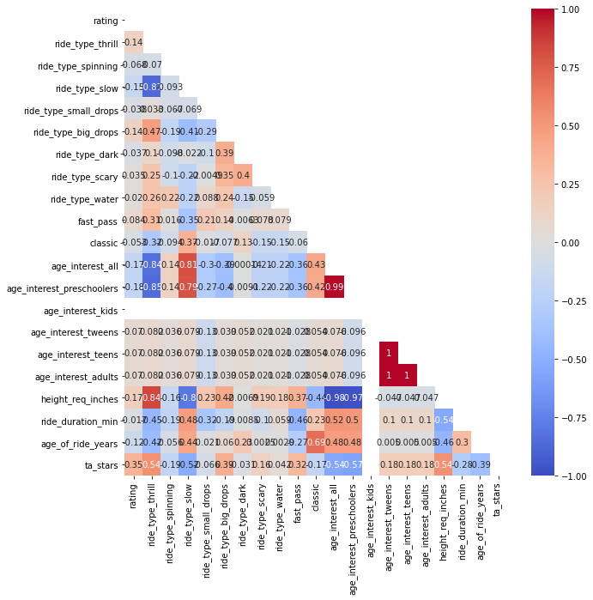
modeling
Adjusted which columns I used or dropped depending on the model (dropped to 17 columns for linear/lasso/ridge regressions – 34 after one-hot encoding)
After adding/removing columns, trying different levels of regularization (including with grid search), could not get a linear regression model based on ride characteristics to explain more than 10% variance

Slide 12
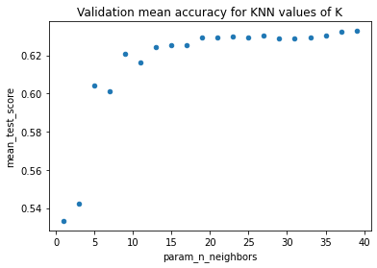
modeling
Predicting ratings can be treated as either a regression or classification problem (https://towardsdatascience.com/1-to-5-star-ratings-classification-or-regression-b0462708a4df)
Tried K nearest neighbors, random forests, and random forests with gradient boosting, but couldn’t come up with a model that did better than the null model (guessing all 5-stars would be 62% accurate)

Slide 13
modeling
Determined that perhaps the ride attribute data wouldn’t work, and wanted to try looking at the textual data instead
Used natural language processing to tokenize the body of the review text and use only those tokens to predict the rating (dropped the ride characteristic features)
Also decided to simplify prediction from multi-classification, to just a binary 1- or 5-star prediction

Slide 14
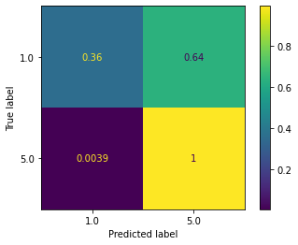
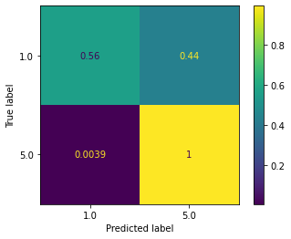

modeling
A
(1) Logistic Regression
Grid Search Pipeline with stop words excluded
(2) Mulitnomal NB
Grid Search Pipeline with stop words included
(3) Mulitnomal NB
Grid Search Pipeline with stop words excluded
Precision: 79%
Recall: 36%
F-1 score: 49%
Precision: 86%
Recall: 56%
F-1 score: 68%
Precision: 74%
Recall: 45%
F-1 score: 56%

Slide 15
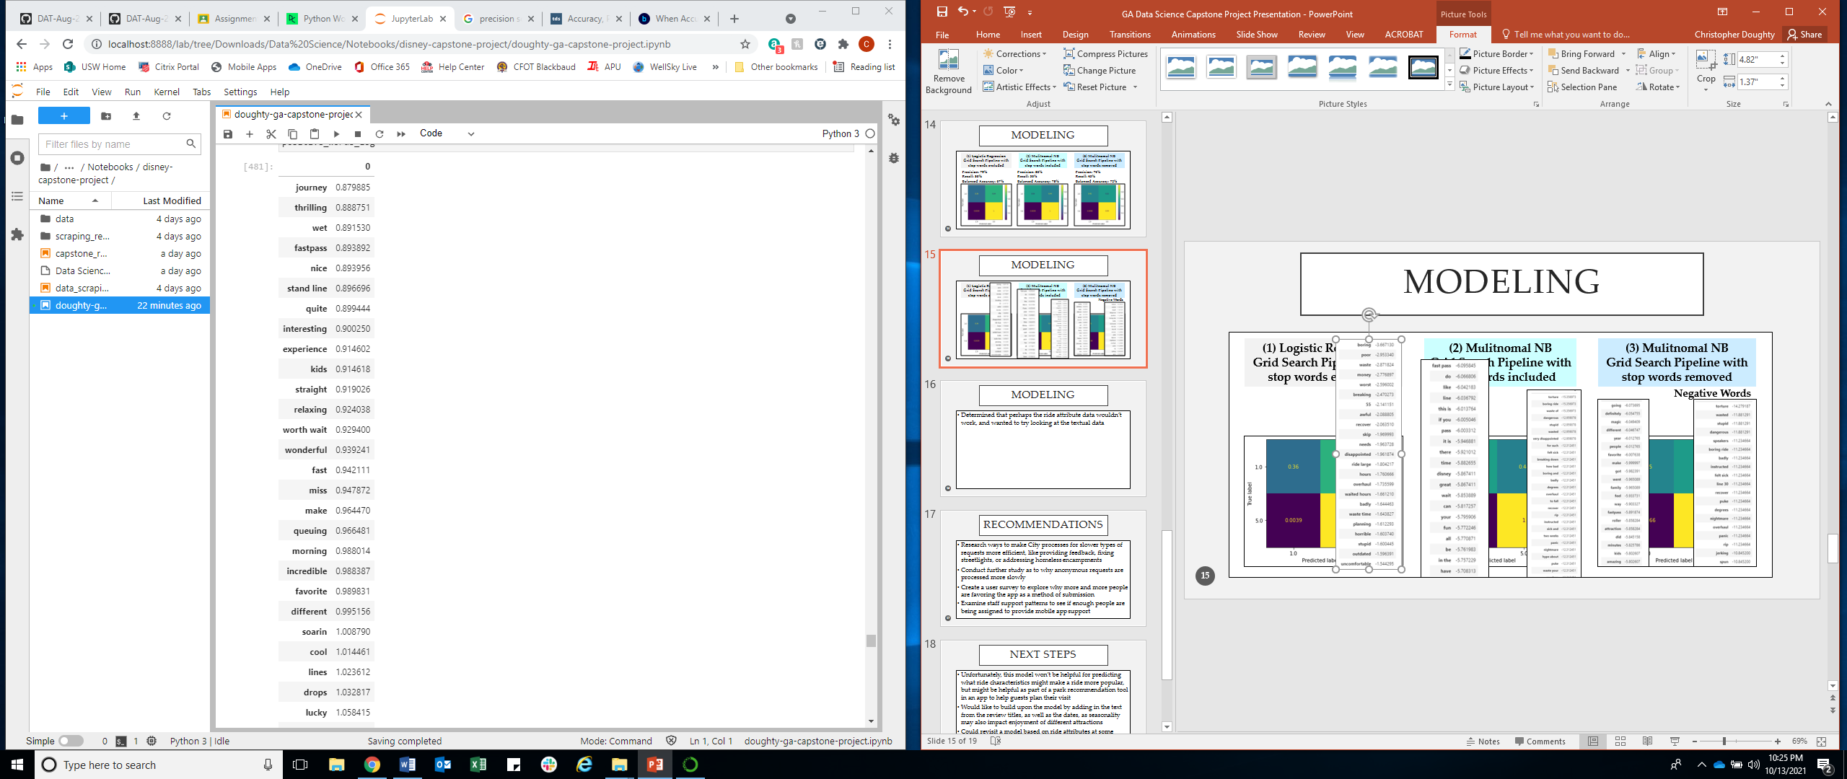
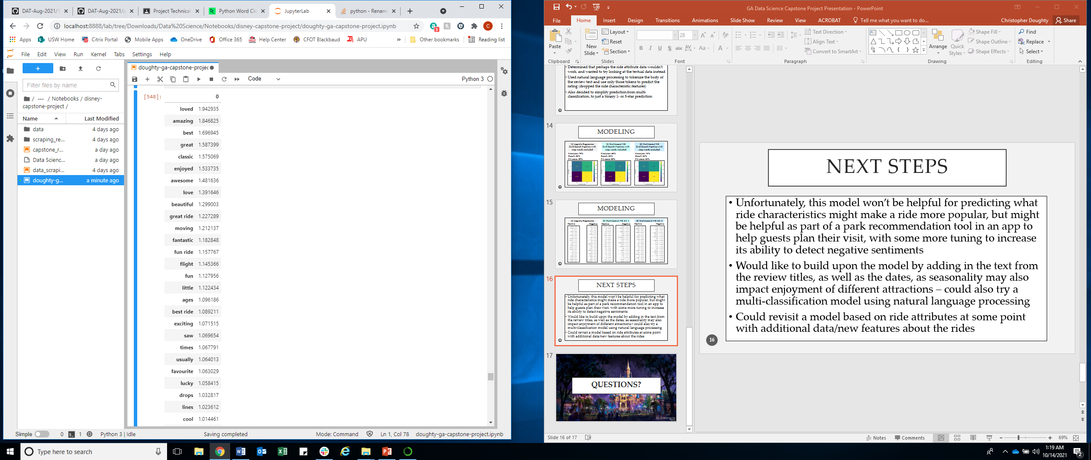
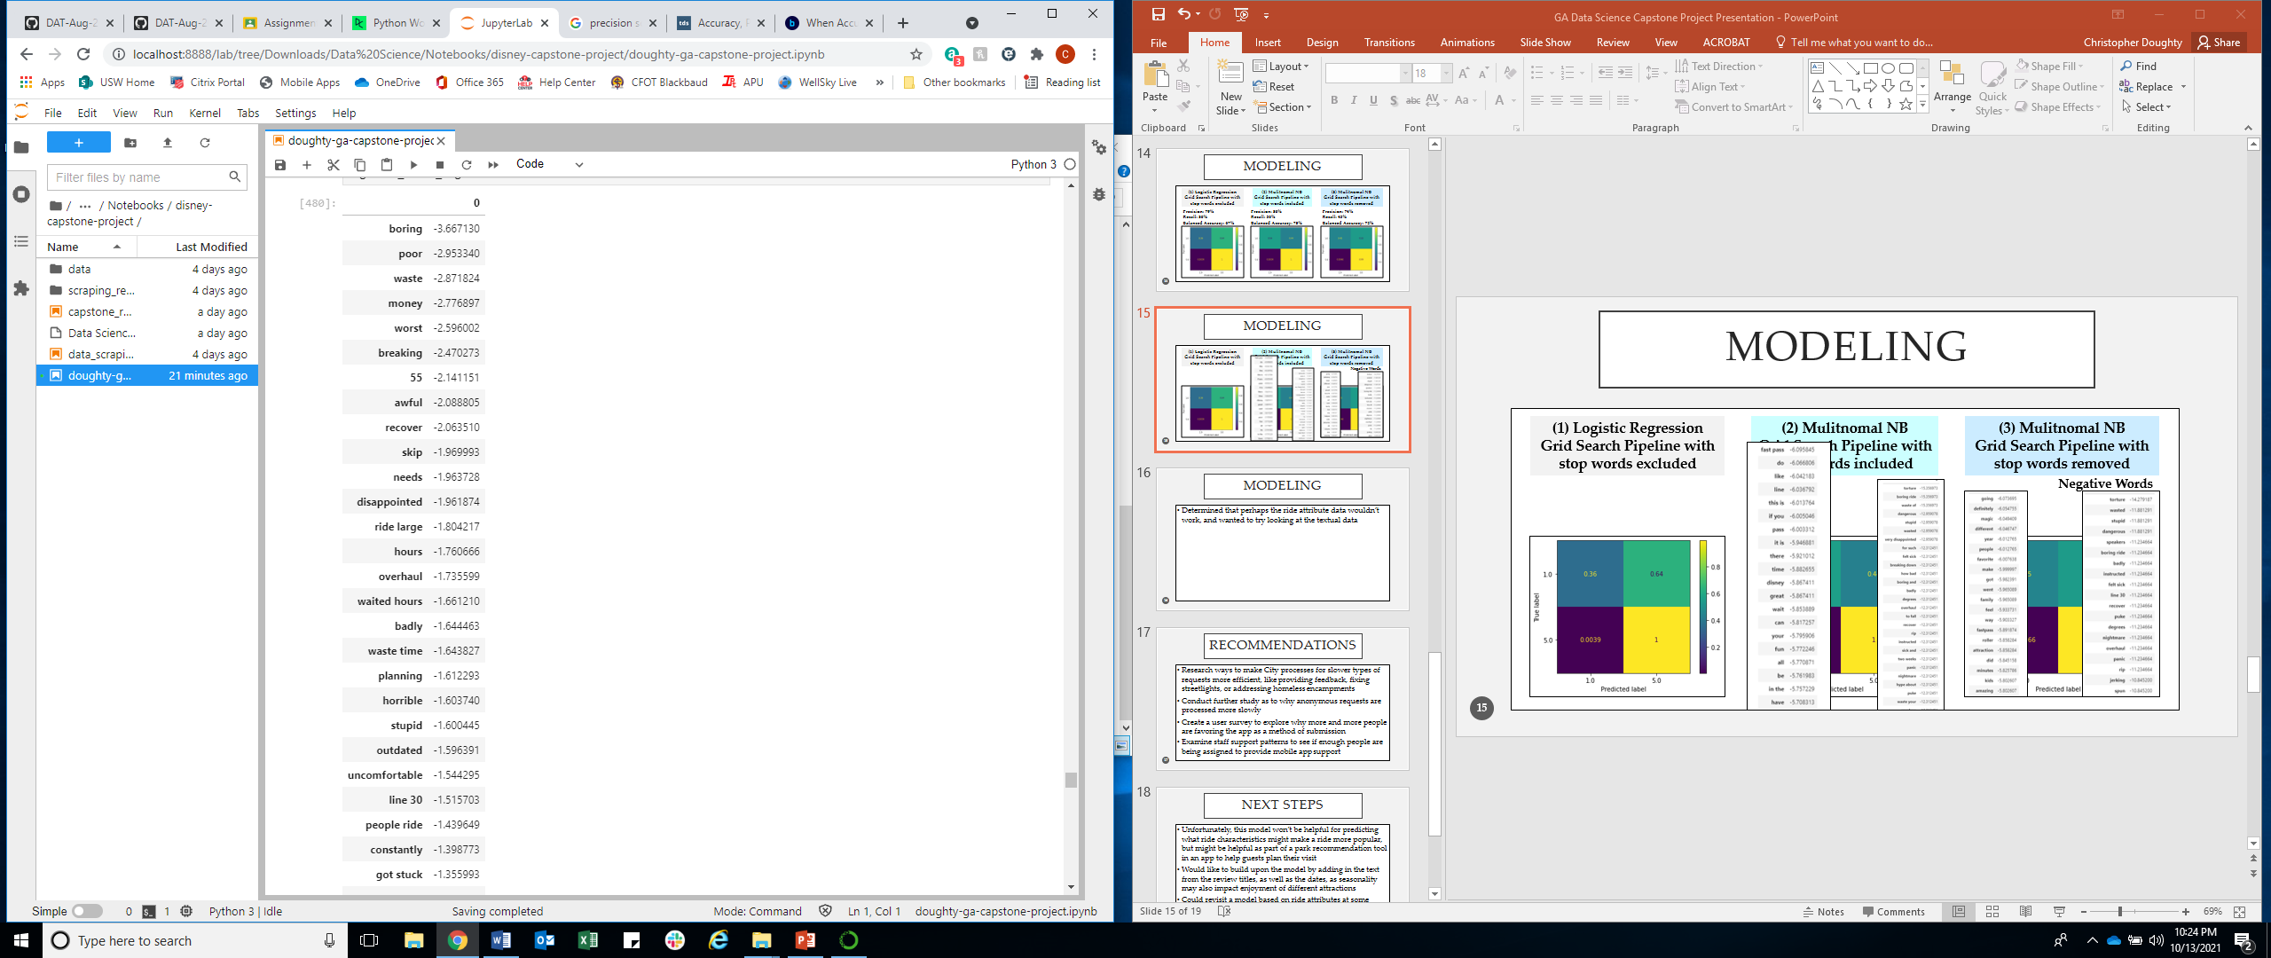
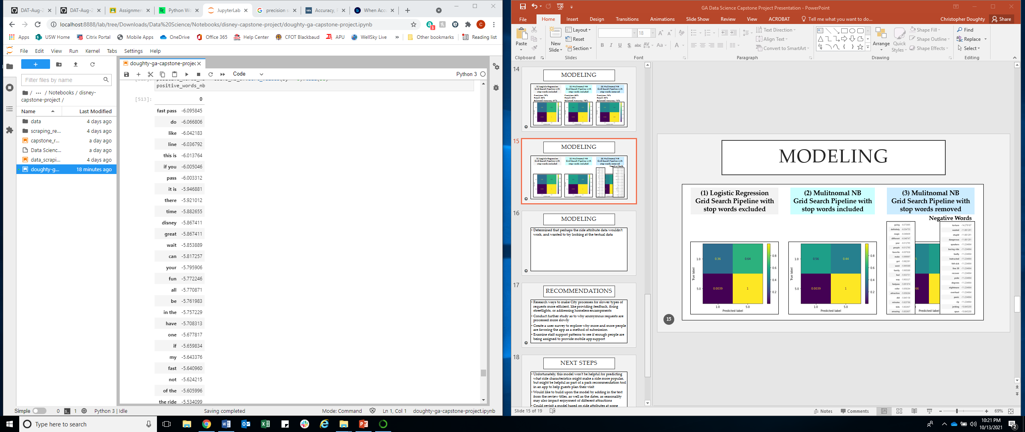
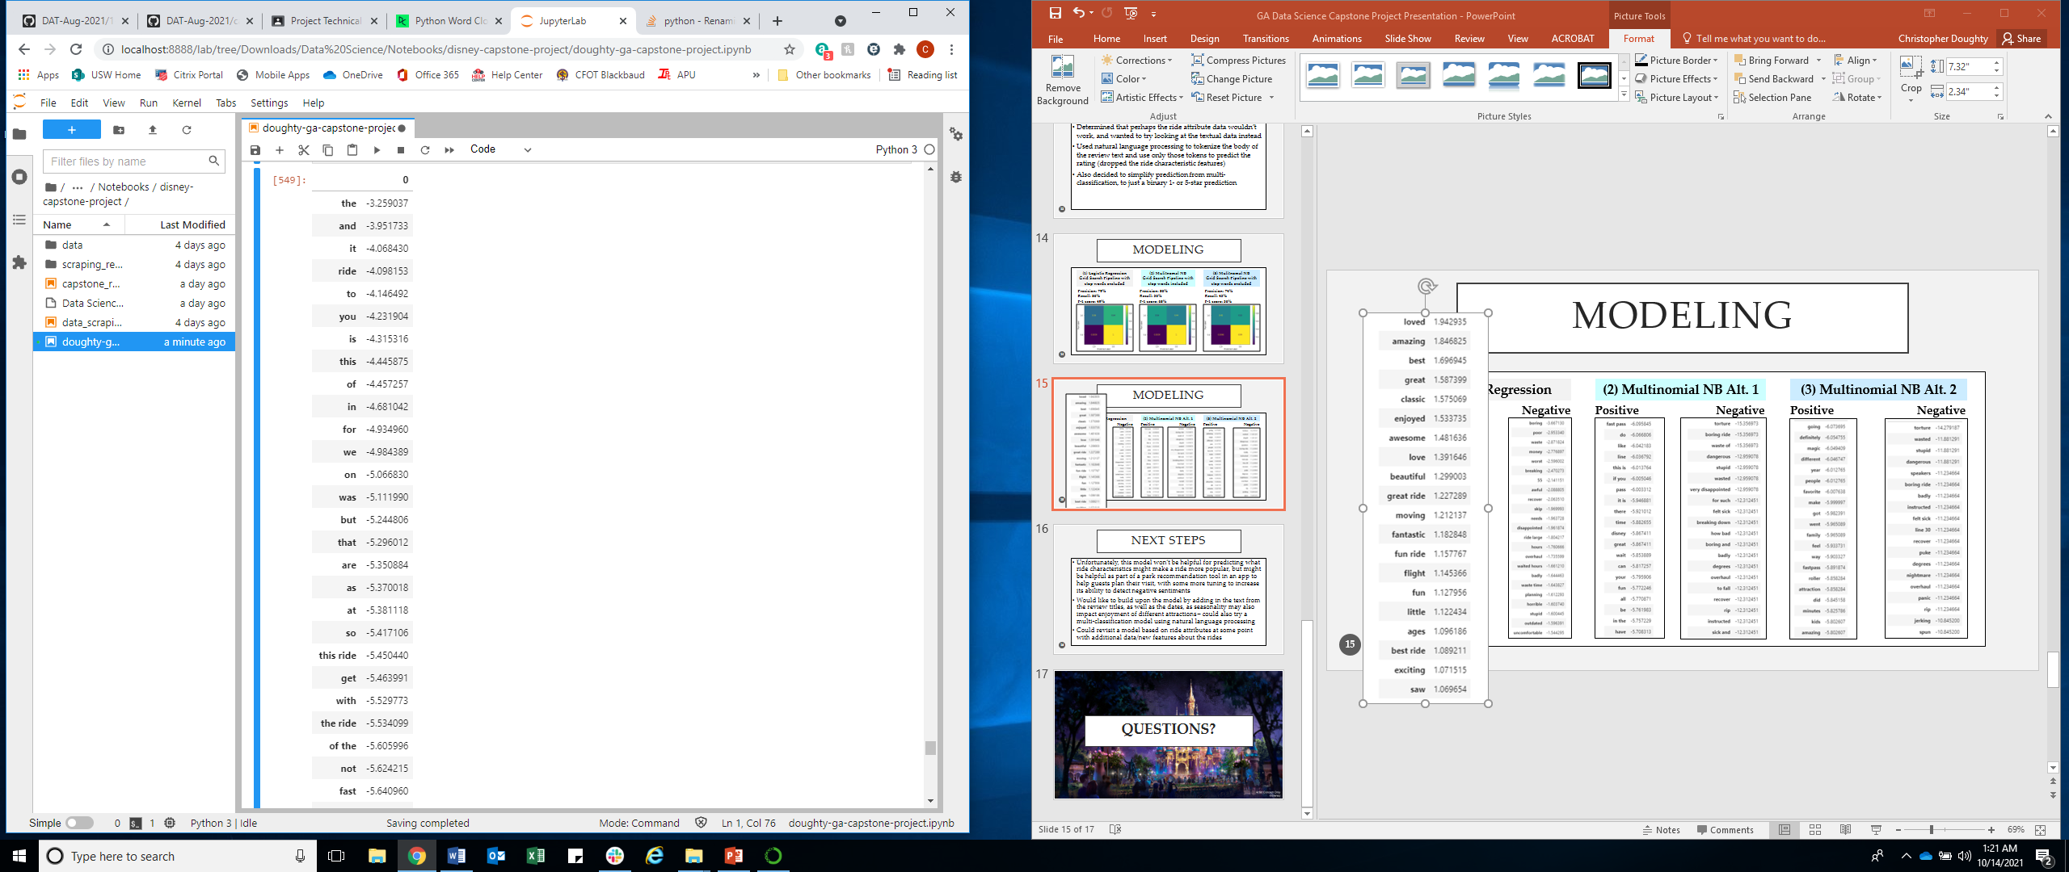
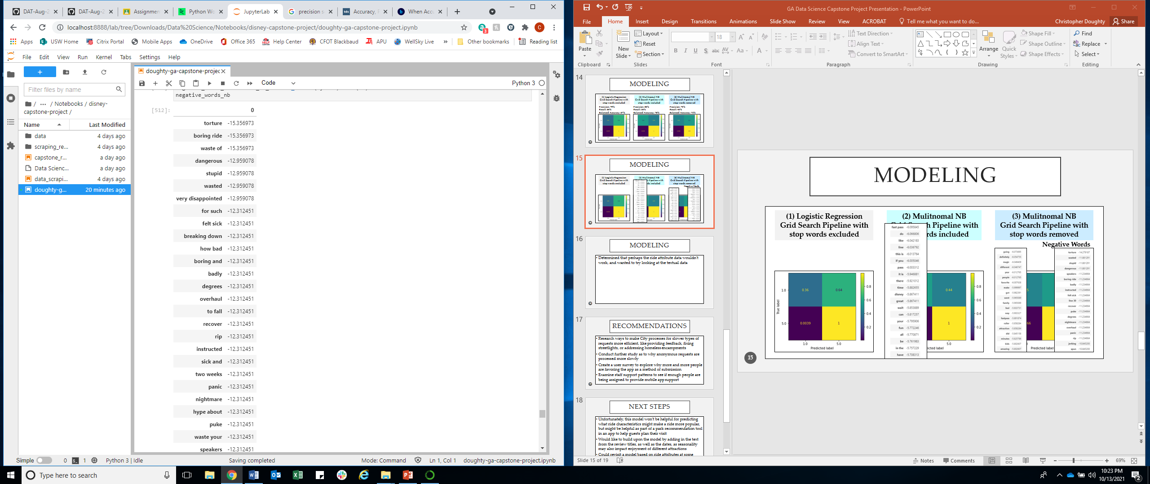
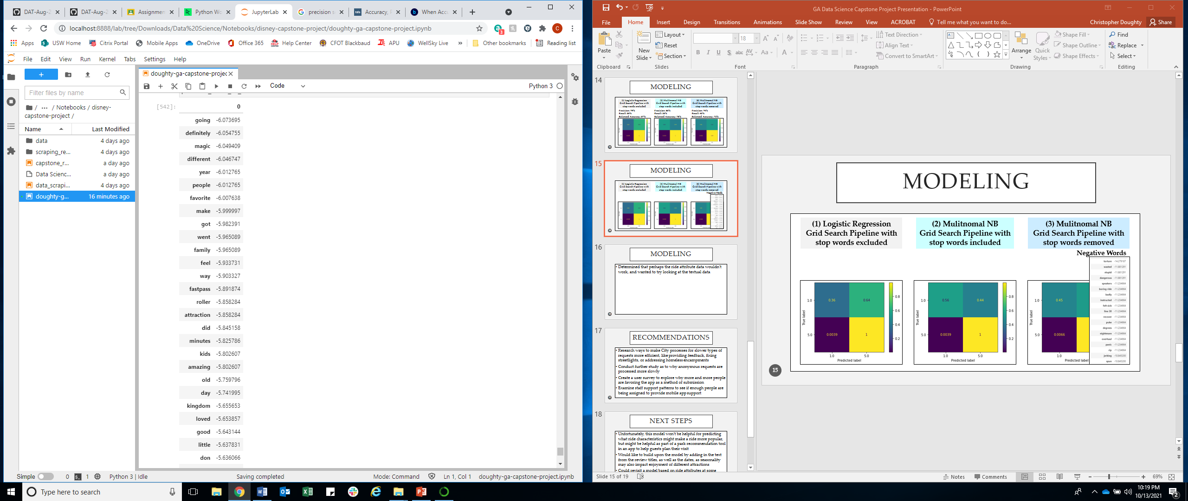

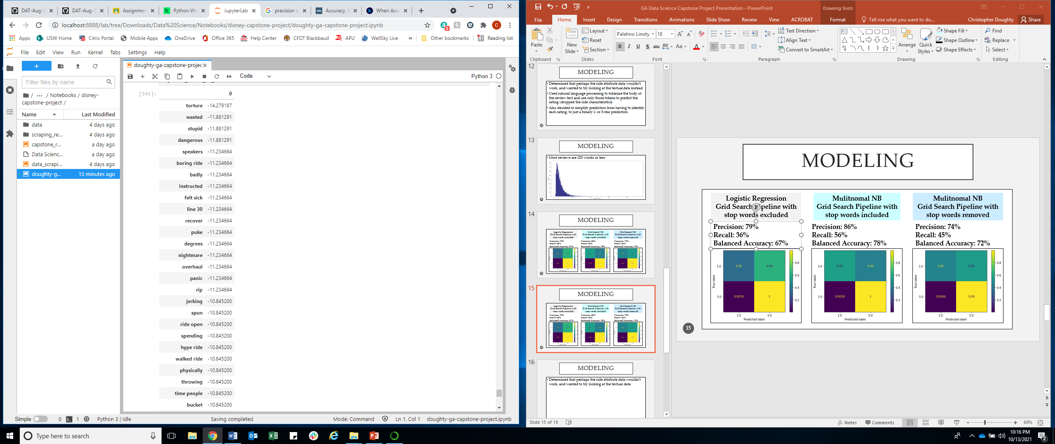
modeling
A
(1) Logistic Regression
(2) Multinomial NB Alt. 1
(3) Multinomial NB Alt. 2
Positive Negative
Positive Negative
Positive Negative

Slide 16
Next steps
Might be helpful as part of a park recommendation tool in an app to help guests plan their visit
Sentiment analysis of the most important words used to predict ratings as a way of identifying best/worst ride characteristics
Would like to build upon the model by adding in the text from the review titles, as well as the dates, as seasonality may also impact enjoyment of different attractions – could also try a multi-classification model using natural language processing
Could revisit a model based on ride attributes at some point with additional data/new features about the rides

Slide 17
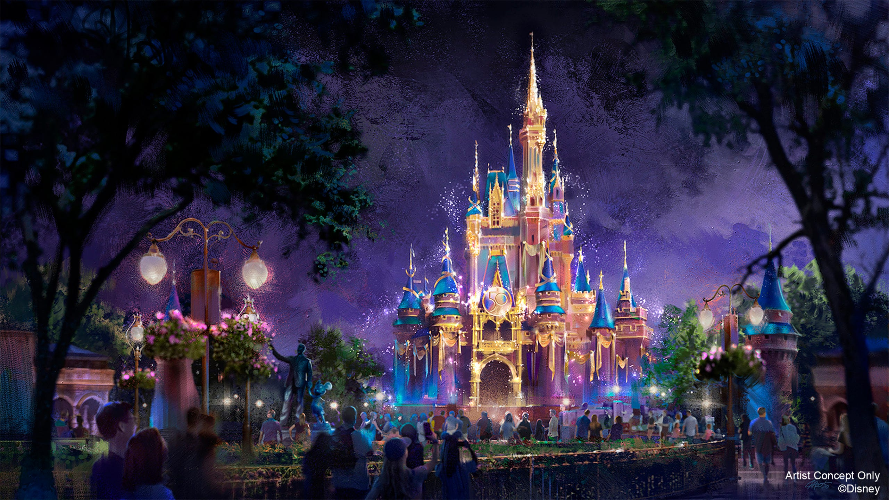
Questions?

